Slide 1
R Files
Excel

Slide 2
Packages
XLSX
Xlconnect
gdata

Slide 3
> install.packages("xlsx") on Rstudio
# Verify the package is installed. any(grepl("xlsx",installed.packages()))
# Load the library into R workspace. library("xlsx")
Dependency on Java

Slide 4
install.packages("XLConnect")
read an excel file with multiple sheets
write an excel file with multiple sheets
read/write formulas
export the results of an analysis in an excel report
This also requires JAVA SDK

Slide 5
ERROR
C:\R\R-3.5.0\bin\R.exe --no-save --quiet
Loading required package: XLConnectJars
Error: package or namespace load failed for 'XLConnectJars':
.onLoad failed in loadNamespace() for 'rJava', details:
call: fun(libname, pkgname)
error: JAVA_HOME cannot be determined from the Registry
Error: package 'XLConnectJars' could not be loaded
Execution halted
Process finished with exit code 1

Slide 6
java sdk download
http://www.oracle.com/technetwork/java/javase/downloads/index.html
Any thing above >=1.8 is good

Slide 7

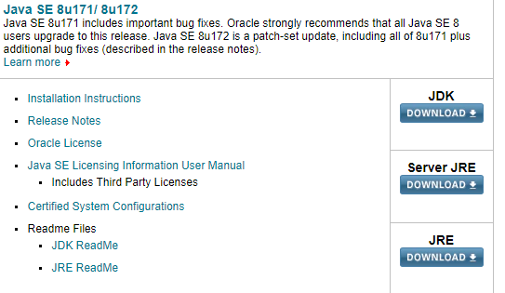
JDK - Windows 64 / Appropriate

Slide 8
success
C:\R\R-3.5.0\bin\R.exe --no-save --quiet
Loading required package: XLConnectJars
XLConnect 0.2-15 by Mirai Solutions GmbH [aut],
Martin Studer [cre],
The Apache Software Foundation [ctb, cph] (Apache POI),
Graph Builder [ctb, cph] (Curvesapi Java library)
http://www.mirai-solutions.com
https://github.com/miraisolutions/xlconnect
Process finished with exit code 0

Slide 9
File - dynamic
filepath ="C:\\Users\\radhapavan\\Documents\\GitHub\\Rprogram\\Files\\" filename="TestExcel.xlsx" filefull = paste(filepath,filename, sep = "") print(filefull)

Slide 10
Write to Excel
#loading the package
require(XLConnect)
#creating an Excel workbook. Both .xls and .xlsx file formats can be used.
wb <- loadWorkbook("XLConnectExample1.xlsx", create = TRUE)
#creating sheets within an Excel workbook
createSheet(wb, name = "chickSheet")
#writing into sheets within an Excel workbook :
#writing ChickWeight data frame into chickSheet
writeWorksheet(wb, ChickWeight, sheet = "chickSheet", startRow = 3, startCol = 4)
#saving a workbook to an Excel file :
#saves a workbook to the corresponding Excel file and writes the file to disk.
saveWorkbook(wb)

Slide 11
loadWorkbook
createSheet
writeWorksheet
saveWorkbook

Slide 12
Explain
# test where is Current working Directory
#print(getwd())
#creating an Excel workbook. Both .xls and .xlsx file formats can be used.
wb <- loadWorkbook(paste(filepath,"XLConnectExample1.xlsx",sep=""), create = TRUE)

Slide 13
In one line !!
require(XLConnect) writeWorksheetToFile("XLConnectExample2.xlsx", data = ChickWeight, sheet = "chickSheet", startRow = 3, startCol = 4)

Slide 14
Add image to excel
Not now
Just show sample output

Slide 15
Try-Catch
inputs = list(1, 2, 4, -5, 'oops', 0, 10) for(input in inputs) { try(print(paste("log of", input, "=", log(input)))) }
Will be discussed later

Slide 16
For large Excel file
# Loading
library("readxl")
# xls files
my_data <- read_excel("D:/Alex/train_price_deal_xl.xlsx")
my_data

Slide 17
Data.table
library(data.table)
mydata<-fread("D:/Alex/train.csv")
head(mydata)

